Slide 1
Static members and methods

Slide 2
Static Members
Java supports definition of global methods and variables that can be accessed without creating objects of a class. Such members are called Static members.
Define a variable by marking with the static keyword .
This feature is useful when we want to create a variable common to all instances of a class.
One of the most common example is to have a variable that could keep a count of how many objects of a class have been created.
Note: Java creates only one copy for a static variable which can be used even if the class is never instantiated.

Slide 3
Static Variables
Define using static:
Access with the class name (ClassName.StatVarName):
public class Circle {
// class variable, one for the Circle class, how many circles
public static int numCircles;
//instance variables,one for each instance of a Circle
public double x,y,r;
// Constructors...
}
nCircles = Circle.numCircles;

Slide 4
Static Variables - Example
Using static variables:
public class Circle {
// class variable, one for the Circle class, how many circles
public static int numCircles = 0;
private double x,y,r;
// Constructors...
Circle (){
numCircles++; }
Circle (double x, double y, double r){
this.x = x;
this.y = y;
this.r = r;
numCircles++; }
CalculateCircumference()
Get and Set for all..
}

Slide 5
Class Variables - Example
Using static variables:
public class CircleRunner{
public static void main(String args[]){
Circle circleA = new Circle( 10, 12, 20); // numCircles = 1
Circle circleB = new Circle(); // numCircles = 2
S.O.P (circleB.numCircle);
}
}
circleA = new Circle(10, 12, 20)
circleB = new Circle(0, 0, 0)
numCircles

Slide 6
Non-static Vs Static Variables
Non-static variables : One copy per object. Every object has its own instance variable.
E.g. x, y, r (centre and radius in the circle)
Static variables : One copy per class.
E.g. numCircles (total number of circle objects created)

Slide 7
Important Points
Use a static variable when all objects of a class must use the same copy of the variable.
Static variables have class scope. We can access a class’s public static members through a reference to any object of the class, or by qualifying the member name with the class name and a dot (.)
A class’s private static class members can be accessed by client code only through methods of the class.

Slide 8
Static Methods
A class can have methods that are defined as static (e.g., main method).
Static methods can be accessed without using objects. Also, there is NO need to create objects.
They are prefixed with keyword “static”
Static methods are generally used to group related library functions that don’t depend on data members of its class. For example, Math library functions.

Slide 9
The Math Class
The Math class provides a number of standard mathematical methods
It is found in the java.lang package, so it does not require an import statement
All of its methods and data are static, therefore they are invoked with the class name Math instead of a calling object
The Math class has two predefined constants, E (e, the base of the natural logarithm system) and PI (π, 3.1415 . . .)
area = Math.PI * radius * radius;

Slide 10
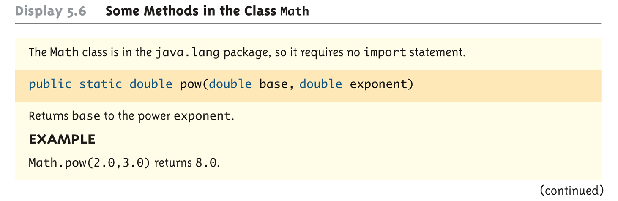
Some Methods in the Class Math (Part 1 of 5)

Slide 11
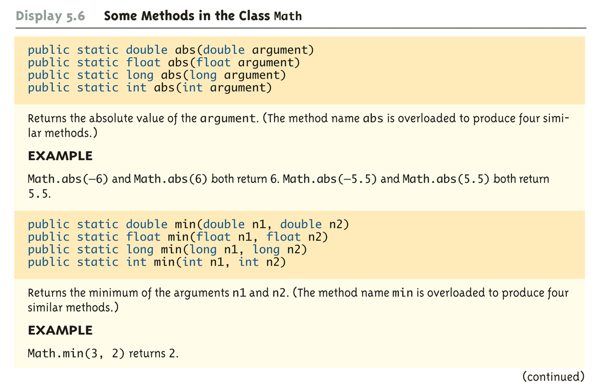
Some Methods in the Class Math (Part 2 of 5)

Slide 12
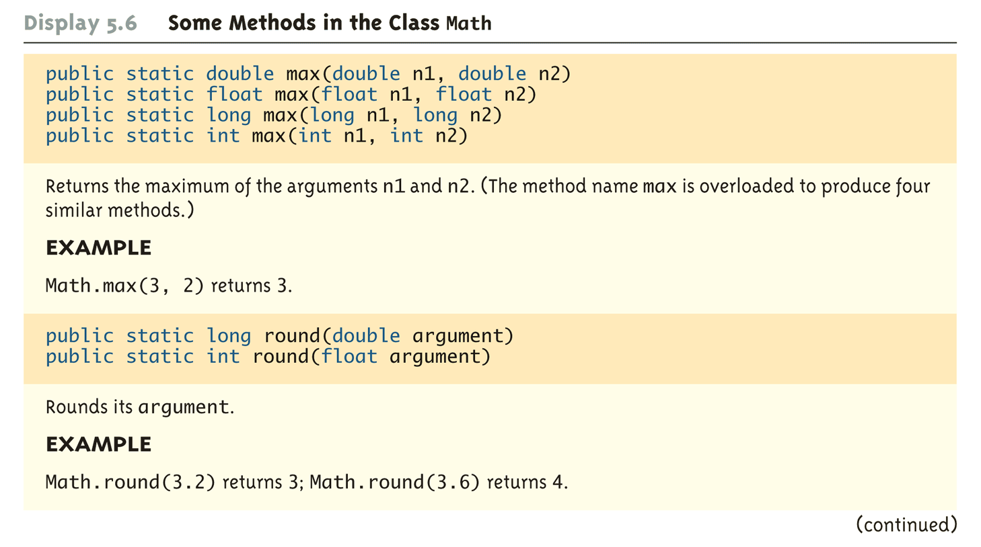
Some Methods in the Class Math (Part 3 of 5)

Slide 13
Comparator class with Static methods
// Comparator.java: A class with static data items comparision methods
class Comparator {
public static int max(int a, int b)
{
if( a > b)
return a;
else
return b;
}
public static String max(String a, String b)
{
if( a.compareTo (b) > 0)
return a;
else
return b;
}
}
Directly accessed using ClassName (NO Objects)

Slide 14
class MyClass {
public static void main(String args[])
{
String s1 = "Melbourne";
String s2 = "Sydney";
String s3 = "Adelaide";
int a = 10;
int b = 20;
System.out.println(Comparator.max(a, b)); // which number is big
System.out.println(Comparator.max(s1, s2)); // which city is big
System.out.println(Comparator.max(s1, s3)); // which city is big
}
}

Slide 15
Static methods restrictions
They can only call other static methods.
They can only access static data.
They cannot refer to “this” or “super” (more later) in anyway.

Slide 16
A static method cannot access non-static class members, because a static method can be called even when no objects of the class have been instantiated.
For the same reason, the this reference cannot be used in a static method. The this reference must refer to a specific object of the class, and when a static method is called, there might not be any objects of its class in memory.

Slide 17
Example – static data and methods
Create a SavingsAccount class.
Use a static data member annualInterestRate to store the annual interest rate.
The class contains a private data member savingsBalance indicating the balance of account.
Provide member function calculateMonthlyInterest that calculates the monthly interest by multiplying the balance by annualInterestRate divided by 12; this interest should be added to savingsBalance.
Provide a static member function modifyInterestRate that sets the static annualInterestRate to a new value.

Slide 18
Write a driver program to test class SavingsAccount. Instantiate two different objects of class SavingsAccount, saver1 and saver2, with balances of $2000.00 and $3000.00, respectively.
Set the annualInterestRate to 3 percent.
Then calculate the monthly interest and print the new balances for each of the savers.
Then set the annualInterestRate to 4 percent, calculate the next month's interest and print the new balances for each of the savers.

Slide 19
Example - Calculator
Create a class TwoDigitCalculator which allows user to perform addition, subtraction, multiplication and division.
Analyse the data members and methods of this class and implement

Slide 20
END

